Slide 2
Who am I?
Chand Kaur
Chief Executive of PCOS Relief, and Founder of PCOS Relief.
Involved in the Healthcare Sector, both NHS as well as the Private Health and Social Care Sector.
On the advisory board for the Women Health Plan in Scotland.
Enquiries@pcosrelief.org
0845 862 3257

Slide 3
PCOS Relief
Charity organisation (SC051494) that supports females who have been diagnosed with PCOS, currently supporting over 2,000 females UK-wide. When establishing PCOS Relief, I knew I wanted to establish a charity that was able to do the following:
Advancement of Education:
Advancement of Health
Promoting Ethnic Minority females diagnosed with this condition.

Slide 4
What is Polycystic Ovary Syndrome?
Polycystic ovary Syndrome is a hormonal reproductive disorder, that affects how a female’s ovaries function.
This condition has an unknown cause and no cure, some say, it could be genetic or environmentally proven but no research to confirm this.
PCOS affects 1 in 10 females in the UK and 1 in 5 females, within Ethnic Minority Communities.
Insulin resistance is present in up to 80% of individuals with PCOS.
High levels of Inflammation is another feature of PCOS.

Slide 5
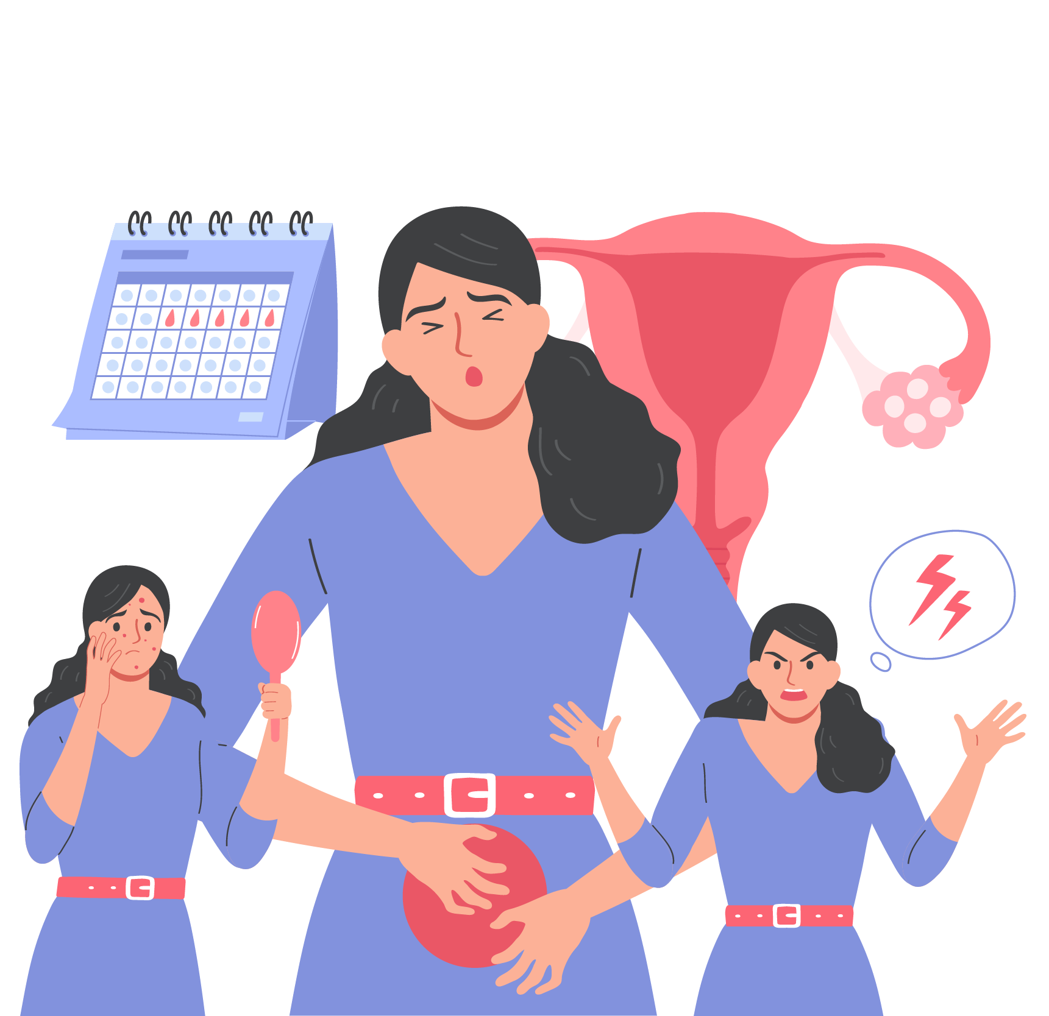
Due to the combination of these factors, symptoms include:
Acne
excess body hair
Weight gain – especially tummy area
Male pattern hair loss
Missed or irregular periods
Fertility issues due to irregular periods or no periods.
Menstrual cycles may be infrequent, irregular, or absent.
Elevated Androgens: Increased levels of male hormones can lead to acne, excess facial/body hair, and hair thinning.
Ovarian Cysts: Small fluid-filled sacs may develop on the ovaries.

Slide 6
What is Insulin Resistance
An estimated 80% of women with PCOS have insulin resistance.
Insulin’s Job: Insulin is like a key that helps cells use sugar (glucose) for energy.
Resistance Develops: Body cells become stubborn, don't respond well to insulin's key.
Sugar Buildup: Sugar stays in blood, causing high blood sugar levels.
Health Impact: Risk of diabetes rises; body works harder to make more insulin.
How does this cause PCOS?
Insulin resistance
Lots of Insulin in the Blood - Too Much Insulin in the Blood – Hormone Imbalance -
Too Much Insulin – Confused Ovaries – Overproduction of Androgens - Excess Androgens
PCOS Symptoms

Slide 7
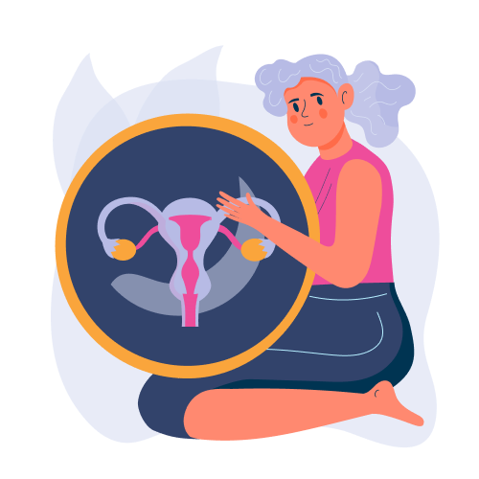
How do you know if you have insulin resistance?
Weight Gain
Constant hunger
Cravings
Frequent Urination
Feeling Thirsty
Skin Changes
Feeling Tired
Irregular Periods
High Blood Pressure
High Cholesterol
Tingling or Numbness and...
PCOS

Slide 8
Our Services
Steering Group
Comfort Talk
Weight Management Classes
Monthly virtual groups
Speak to a Qualified Mental Health Advisor.
12 Week weight management classes
Diet and Nutrition Classes
Empowering Communities
12 Week Diet and Nutrition Classes
Raising PCOS Awareness within Community areas

Slide 9
How can we support a female diagnosed with PCOS in a Work Environment?
Be Supportive
Raise Awareness
Normalize talking about Women’ Health - Period - PCOS
Create a safe space within your workforce.
Flexible working opportunities
Research PCOS / Women Health conditions
Notice Board – containing awareness about PCOS especially during September as it is PCOS Awareness Month
Stock up Women Hygiene products in toilets
Recruitment Process at Women Health Questions – PCOS

Slide 10
Achievements
Supporting over 2,000 females UK wide
NHS Inform Website
Scottish Parliament Event
Creating a PCOS policy for workforces
PCOS Relief supports the Women Health Plan Scotland - advisory for PCOS patients.
International Women Day - Kiehls Events
Secured founding for in-person workshops
UAE Fertility clinic, that supports our members with fertility treatment – over 80% success rate
Working with the Scottish Government
Education workshops in India and provides Women Hygiene products

Slide 11
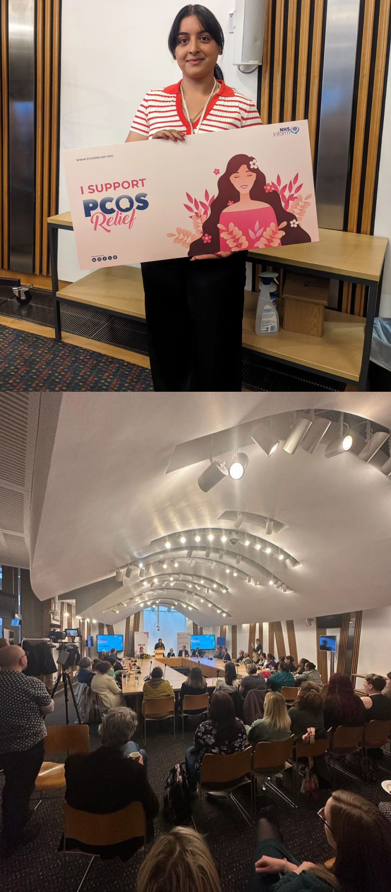
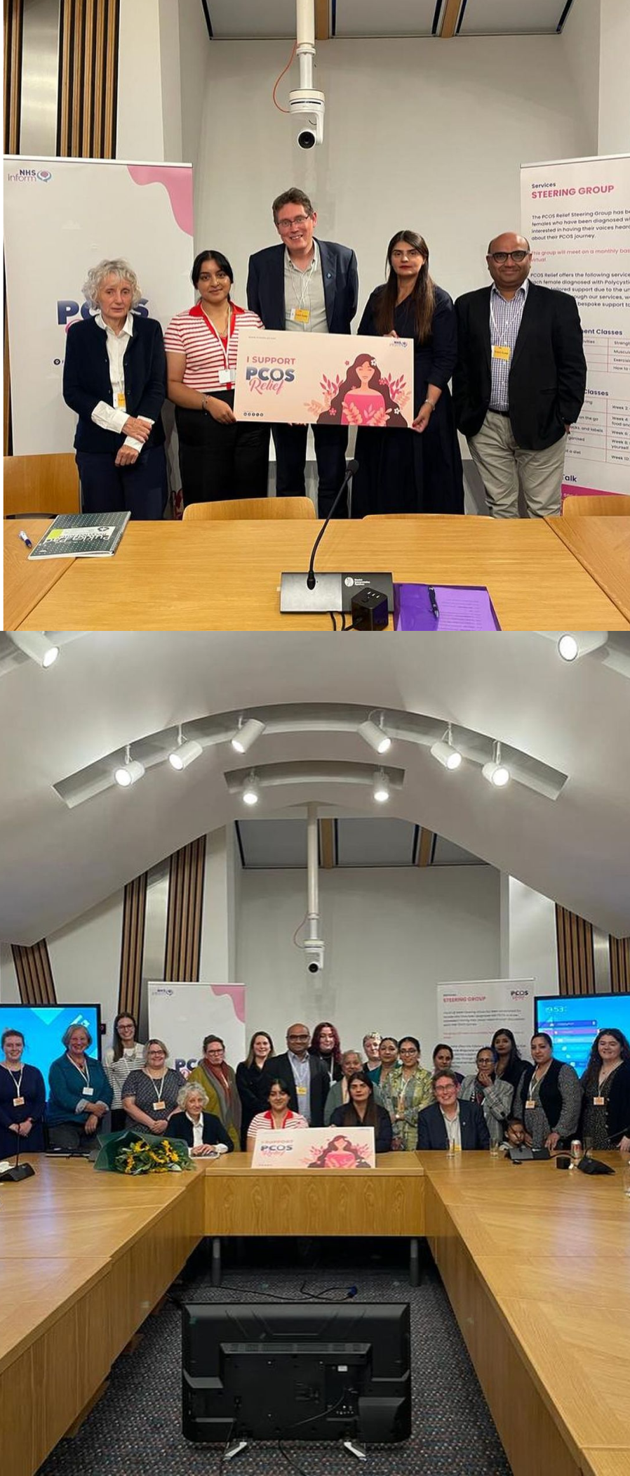
Thanks
Do you have any questions?
Enquiries@pcosrelief.org | 0845 862 3257 www.pcosrelief.org

