Slide 1
The Royal Wolverhampton NHS Trust “Freecycle” Scheme
Janet Smith
Joint Head of Sustainability
Royal Wolverhampton and Walsall Healthcare NHS Trusts

Slide 2

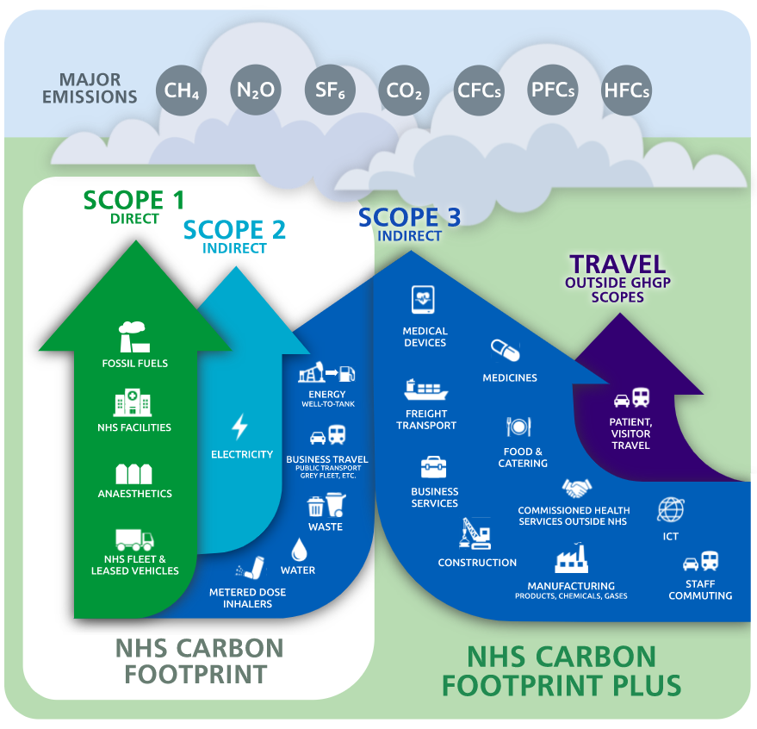
Focus on
Within the Trust
  Fostering the principles of recycling, upcycling and social value
  Waste reduction
  Cost savings
  Contribute to the Trust goal to achieve net zero carbon by 2040
Within the ICS
  Establish a furniture/equipment/ technology sharing/exchange
  Shared reporting mechanism for carbon footprint reduction, cost savings and social value impact

Slide 3

Process
Within the Trust
  All refurbishment and new building schemes – transfer before new is the ethos
  Agreement with Procurement to advise staff to check the inventory before ordering new
  Inventory of stored usable furniture & equipment available for staff to browse
  Delivery cost charged to department
  Out of specification equipment, furniture, etc donated to charities/social enterprise
Within the ICS
  List of available goods sent out to freecycle workstream members via the PMO
  Items are free
  Recipient Trust pays for collection cost

Slide 4



Challenges
Within the Trust and ICS
  Storage
  Voluntary Sector Organisation – Access to NHS Procurement System
Opportunities
Collaboration with VSO, Anchor institutions, regional and national partners
Supply chain engagement and support

Slide 5
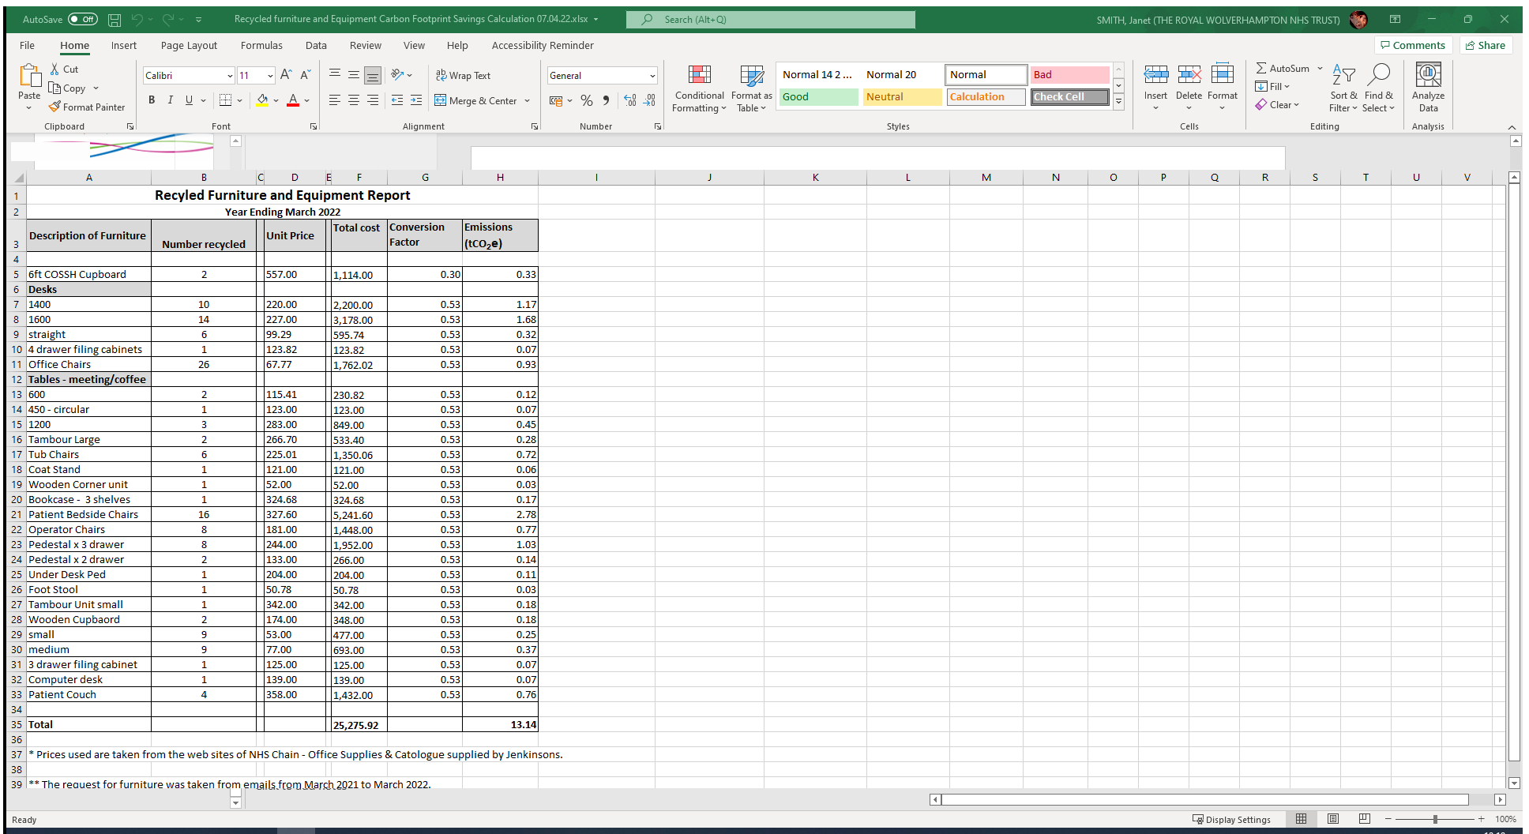
Reporting mechanism

Slide 6

QUESTIONS?

