Slide 1
What are the consequences of mandatory vaccination for the social care workforce?
Wednesday, August 25, 2021

Slide 2
1045
Total Responses
Date Created: Friday, August 20, 2021
Complete Responses: 1045

Slide 3
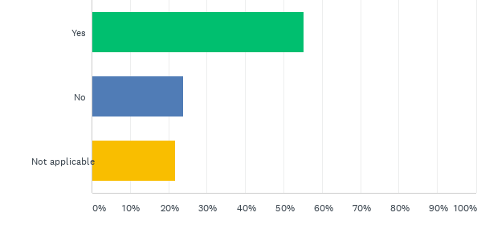
Q1: Care Homes - based on current vaccination rates of your staff, will you have to dismiss staff ahead of November 11?
Answered: 1,045 Skipped: 0

Slide 4
Q1: Care Homes - based on current vaccination rates of your staff, will you have to dismiss staff ahead of November 11?
Answered: 1,045 Skipped: 0

Slide 5
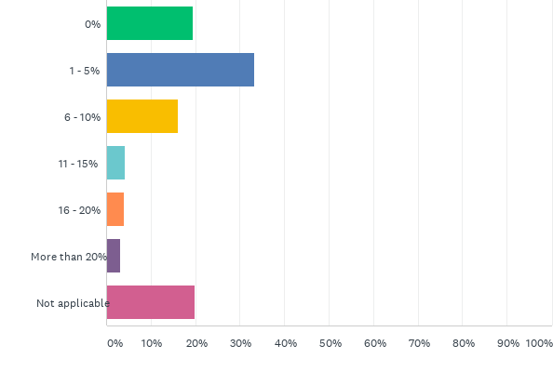
Q2: Care Homes - what proportion of staff do you expect to lose in total by November 11 because they are not vaccinated?
Answered: 998 Skipped: 47

Slide 6
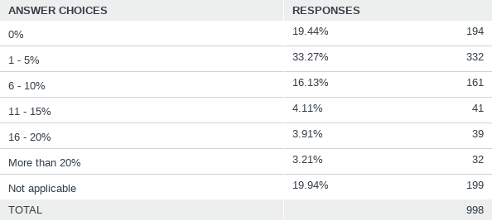
Q2: Care Homes - what proportion of staff do you expect to lose in total by November 11 because they are not vaccinated?
Answered: 998 Skipped: 47

Slide 7
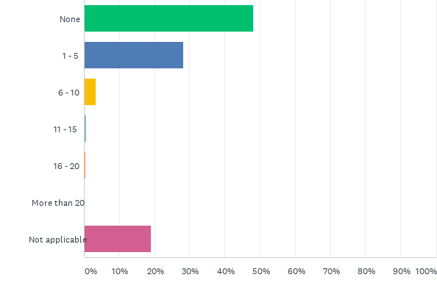
Q3: Care Homes - how many staff have already left or handed in their notice due to their opposition to mandatory vaccination?
Answered: 986 Skipped: 59

Slide 8
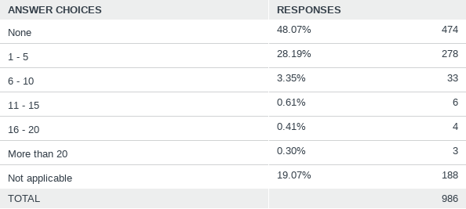
Q3: Care Homes - how many staff have already left or handed in their notice due to their opposition to mandatory vaccination?
Answered: 986 Skipped: 59

Slide 9
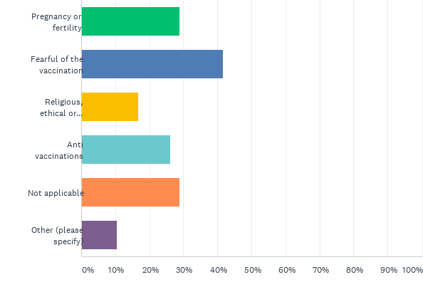
Q4: Care Homes - what are the main reasons your staff are giving for not getting vaccinated?
Answered: 930 Skipped: 115

Slide 10
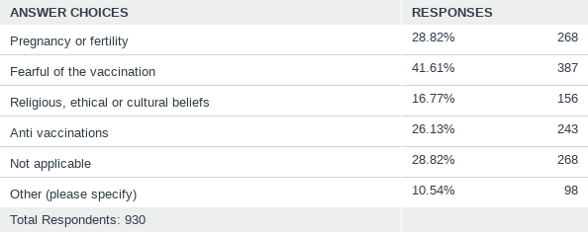
Q4: Care Homes - what are the main reasons your staff are giving for not getting vaccinated?
Answered: 930 Skipped: 115

Slide 11
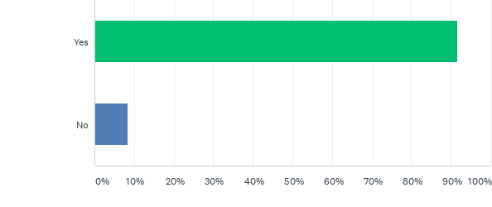
Q5: Are you experiencing workforce issues such as understaffing and difficulty recruiting?
Answered: 925 Skipped: 120

Slide 12
Q5: Are you experiencing workforce issues such as understaffing and difficulty recruiting?
Answered: 925 Skipped: 120

Slide 13
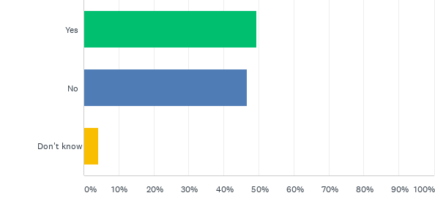
Q6: Are workforce issues compromising care and safety within your service?
Answered: 921 Skipped: 124

Slide 14
Q6: Are workforce issues compromising care and safety within your service?
Answered: 921 Skipped: 124

Slide 15
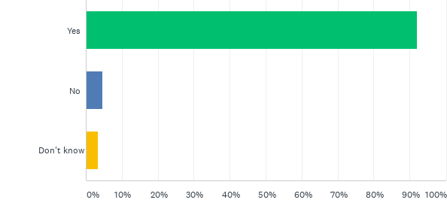
Q7: Do you think care and safety will be compromised if workforce problems increase?
Answered: 919 Skipped: 126

Slide 16
Q7: Do you think care and safety will be compromised if workforce problems increase?
Answered: 919 Skipped: 126

Slide 17
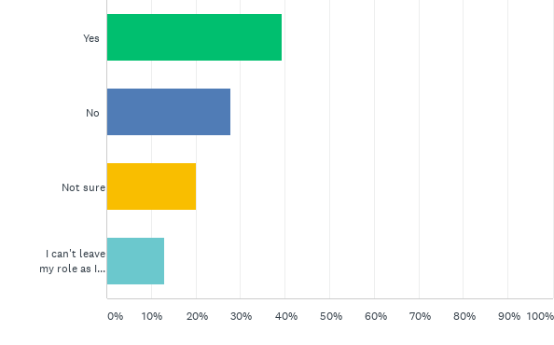
Q8: Are you considering leaving your role as manager?
Answered: 914 Skipped: 131

Slide 18
Q8: Are you considering leaving your role as manager?
Answered: 914 Skipped: 131

Slide 19
Q9 Do you have any comments about how things are in social care at present? Wordcloud

